Slide 1



Recommenders Systems: from traditional approaches to Sheaf Neural Networks
Antonio Purificato
3rd year PhD Student @ Sapienza University of Rome
Applied Scientist Visitor @ Amazon Research
Prague, 20.11.2025
Website

Slide 2

A Reproducible Analysis of Sequential Recommender Systems
IEEE Access Journal, 2024
Filippo Betello*, Antonio Purificato*, Federico Siciliano*, Giovanni Trappolini, Andrea Bacciu, Nicola Tonellotto, Fabrizio Silvestri

Slide 3

Recommendation Systems
Homer is bored and he decides to turn on the television and open Netflix to watch a TV series.

Slide 4

Recommendation Systems
Homer decides watching Breaking Bad.

Slide 5

Recommendation Systems
He watches it until he finishes the last season.

Slide 6

Recommendation Systems
Now Homer has to select which new TV series wants to watch.

Slide 7



Sequential Recommendation
Goal: predict the next (future) interaction in a chronologically ordered sequence of user-item interactions (historical).
?

Slide 8
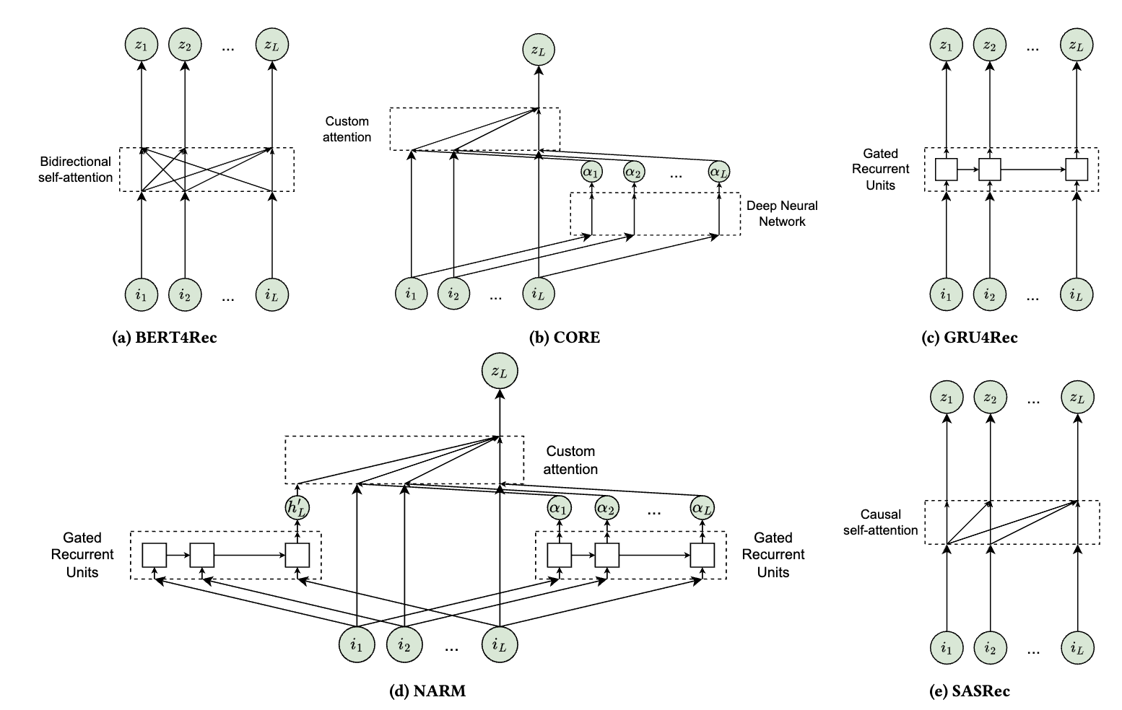
An Introduction
Sequential Recommender Systems (SRSs) have received significant attention for their ability to consider the temporal dynamics inherent in user preferences.
The main goal of SRSs is to predict the next item a user is going to interact with, based on the sequence of user’s previous interactions.
Models as GRU4Rec, BERT4Rec or SASRec have marked significant milestones in this evolution.
A Reproducible Analysis of Sequential Recommender Systems

Slide 9
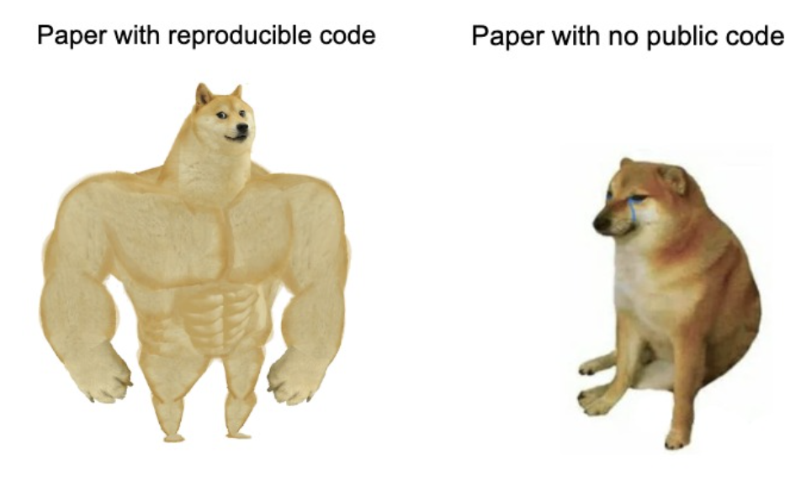
Problems
The reproducibility of these models remains an open problem, due to:
Lack of standardised benchmarks;
Not uniform data pre-processing;
Inconsistent model implementations
A Reproducible Analysis of Sequential Recommender Systems

Slide 10
Our solution
Code resource allowing different data pre-processing methods, facilitating the implementation of various SRSs, and ensuring reproducibility.
Experiments on multiple datasets and models, reducing biases in performance comparisons.
Analysis of the results, with new insights about different models and the impact of key hyperparameters;
A Reproducible Analysis of Sequential Recommender Systems

Slide 11
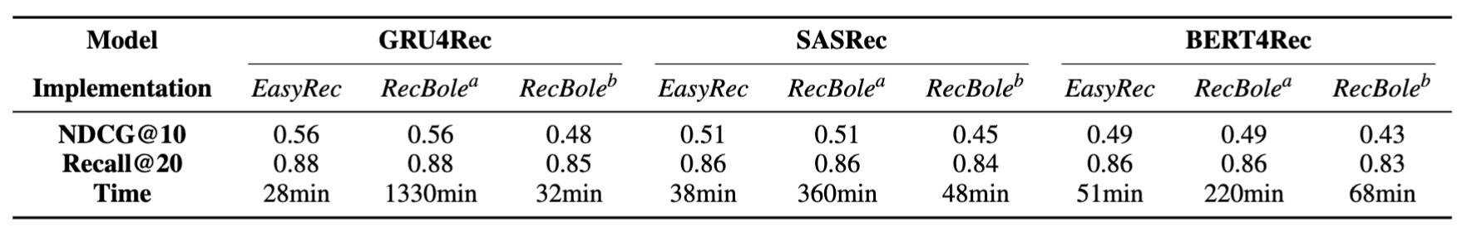
Why EasyRec?
A Reproducible Analysis of Sequential Recommender Systems

Slide 12
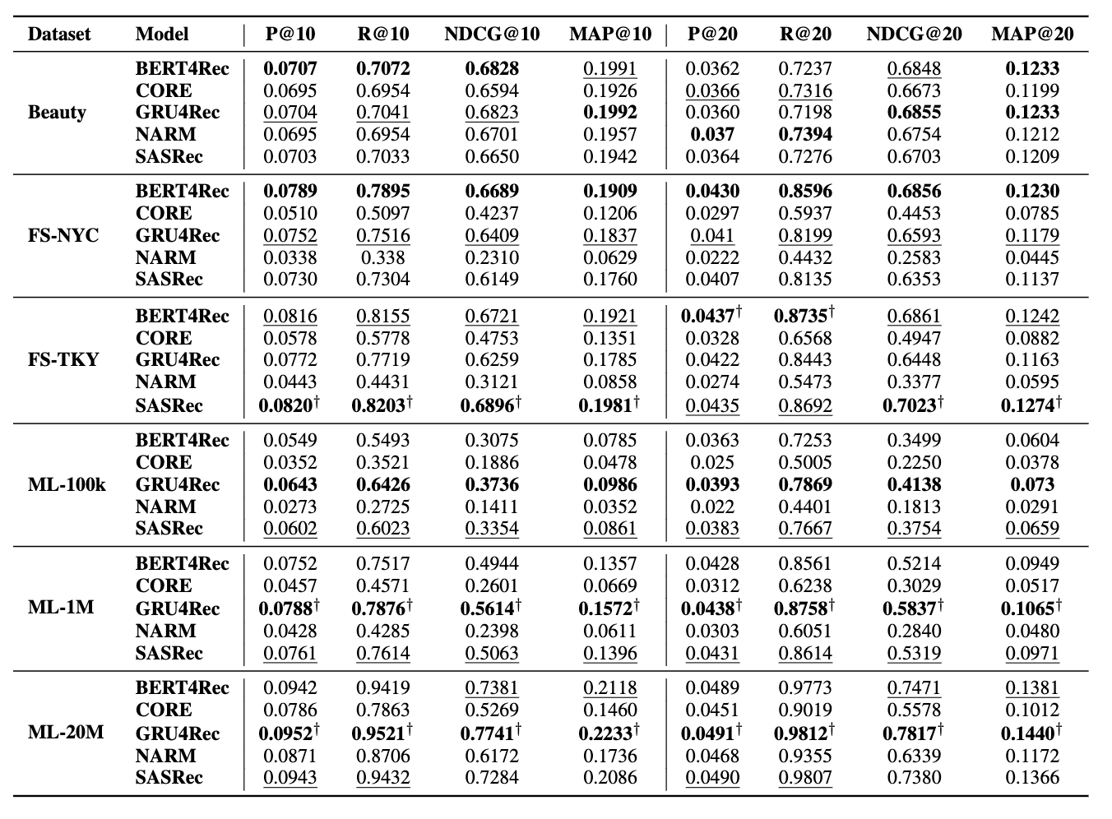
Results
GRU4Rec consistently shows strong performance, often outperforming other SRSs.
A Reproducible Analysis of Sequential Recommender Systems

Slide 13
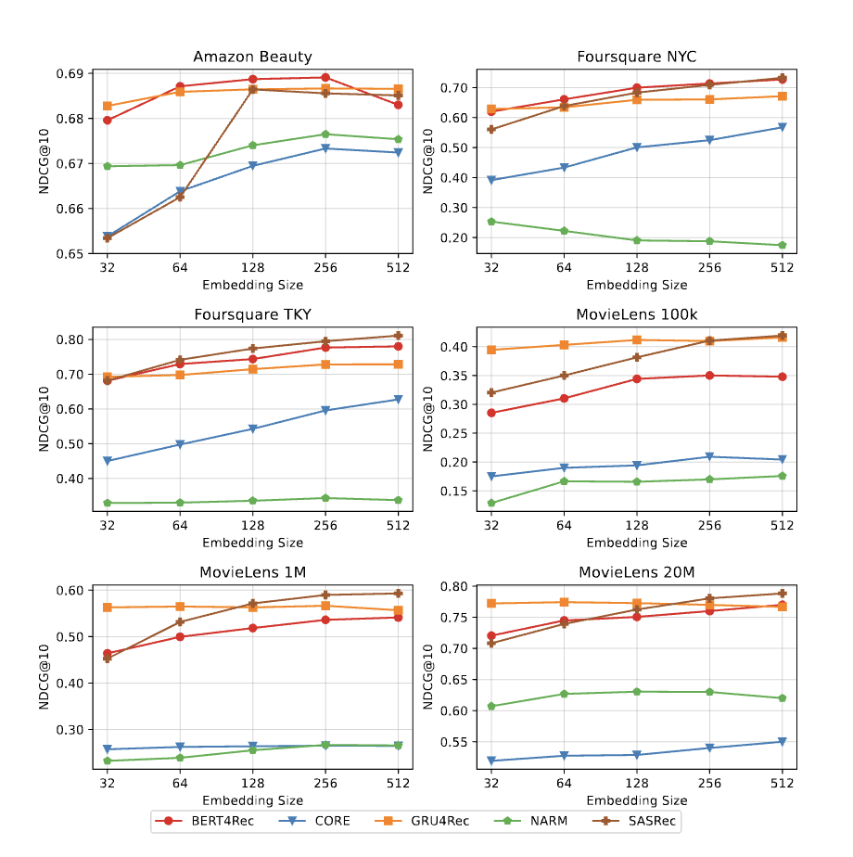
Our insights - Embedding Size
Performance gains for transformer-based models are more pronounced at higher embedding dimensions compared to GRU-based models.
A Reproducible Analysis of Sequential Recommender Systems

Slide 14
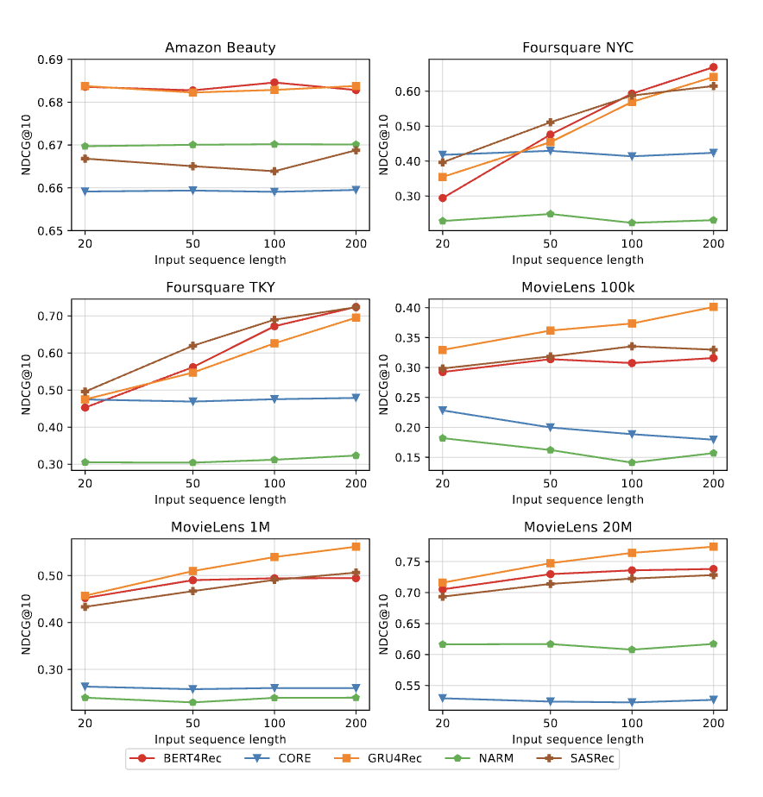
Our insights - Sequence Length
The optimal input sequence length is closely related to the average user sequence length of each dataset.
A Reproducible Analysis of Sequential Recommender Systems

Slide 15
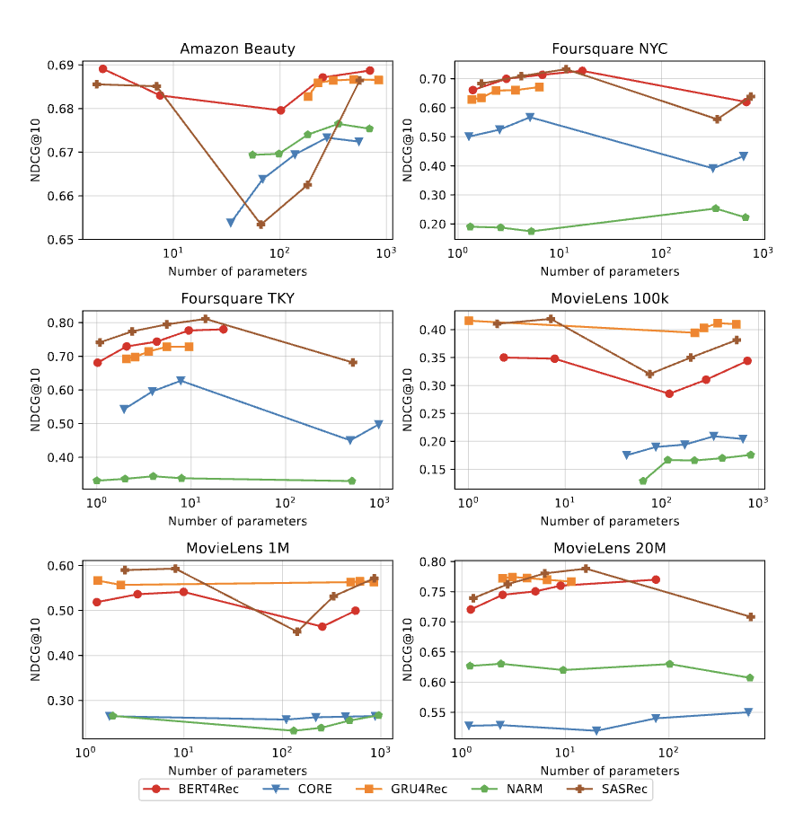
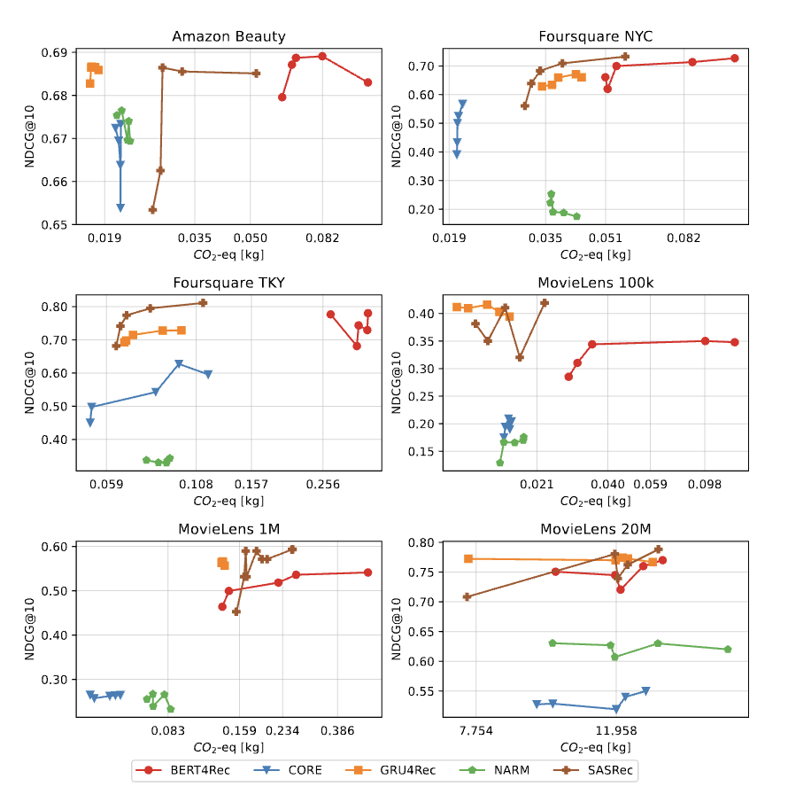
Our insights - CO₂ Impact
A Reproducible Analysis of Sequential Recommender Systems

Slide 16



Conclusions
✉️ {betello, purificato, siciliano} @diag.uniroma1.it
🌐 https://rstless.it/
@RSTLessGroup
New RecSys library easy to use, fast, scalable that outperforms current libraries.
Transformer-based models exhibit exponential growth in size with increasing embedding dimensions, but performance improvements do not scale similarly.
Emissions are significantly higher for models that require longer training times.
Paper
Github Code
A Reproducible Analysis of Sequential Recommender Systems

Slide 17

Are Convolutional Sequential Recommender
Systems Still Competitive? Introducing New
Models and Insights
International Joint Conference on Neural Networks (IJCNN), 2025
Federico Siciliano*, Antonio Purificato*, Filippo Betello*, Nicola Tonellotto, Fabrizio Silvestri

Slide 18
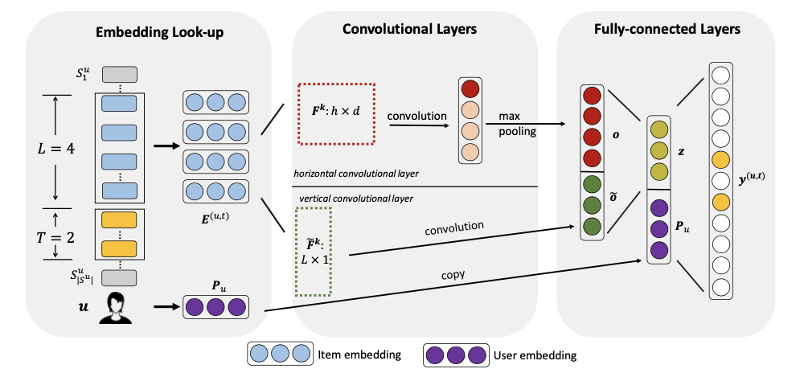
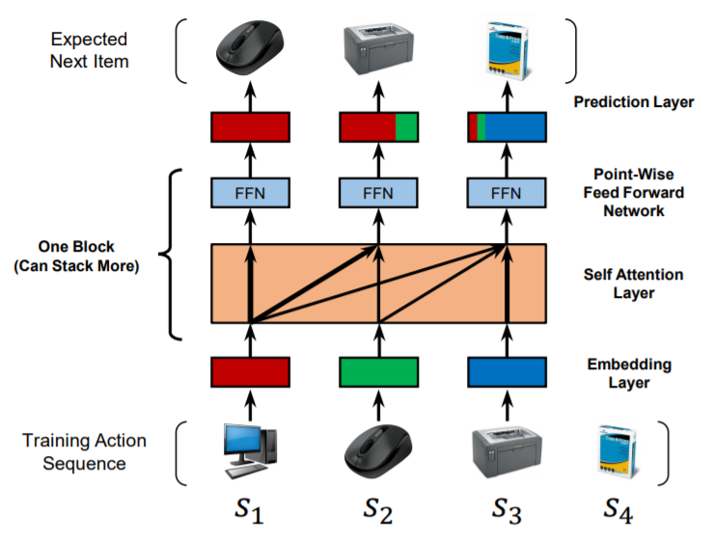
Standard vs Convolutional
Caser
SASRec
Are Convolutional Sequential Recommender Systems Still Competitive? Introducing New Models and Insights

Slide 19
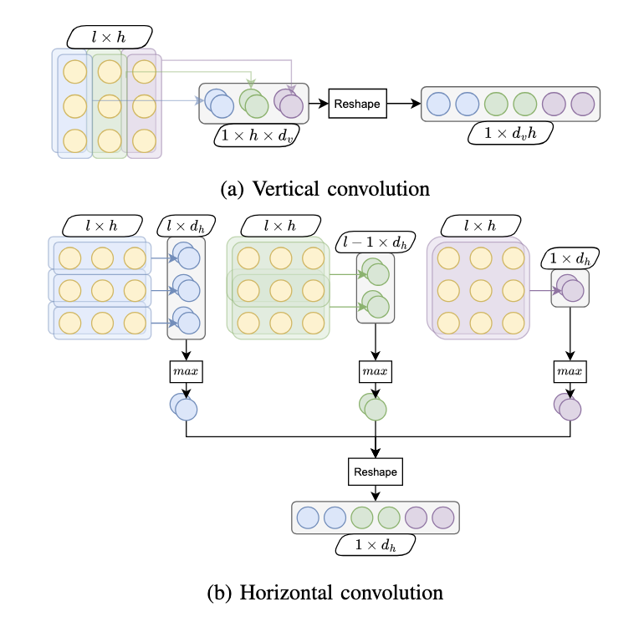
Caser
In the vertical layer, each filter of length l aggregates a single dimension of the embeddings of all items in the sequence.
The horizontal convolution consists of several convolutional layers, one for each sequence length.
Are Convolutional Sequential Recommender Systems Still Competitive? Introducing New Models and Insights

Slide 20

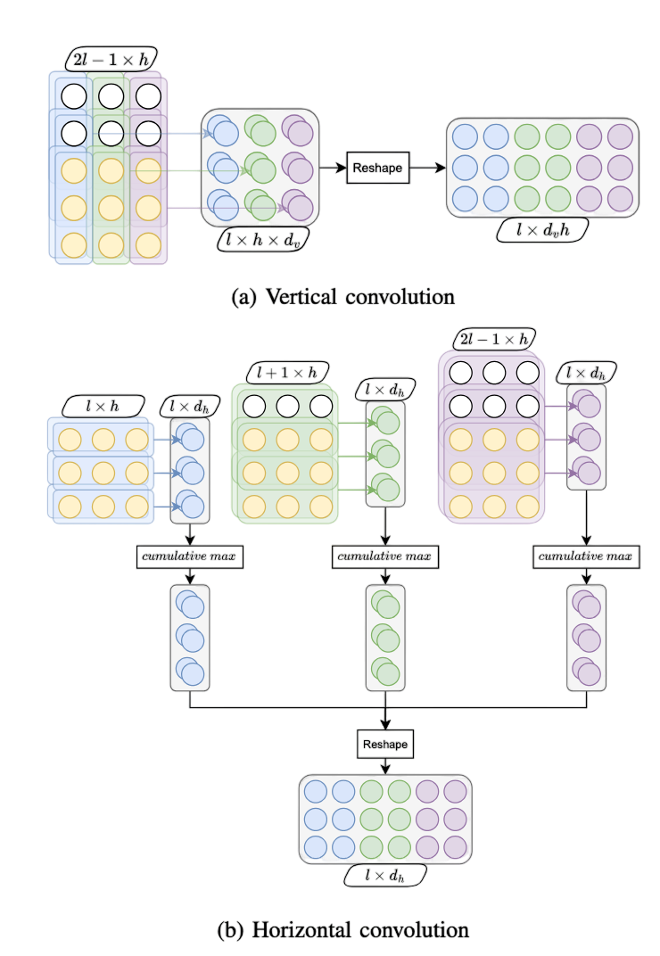
Caser+
Are Convolutional Sequential Recommender Systems Still Competitive? Introducing New Models and Insights

Slide 21
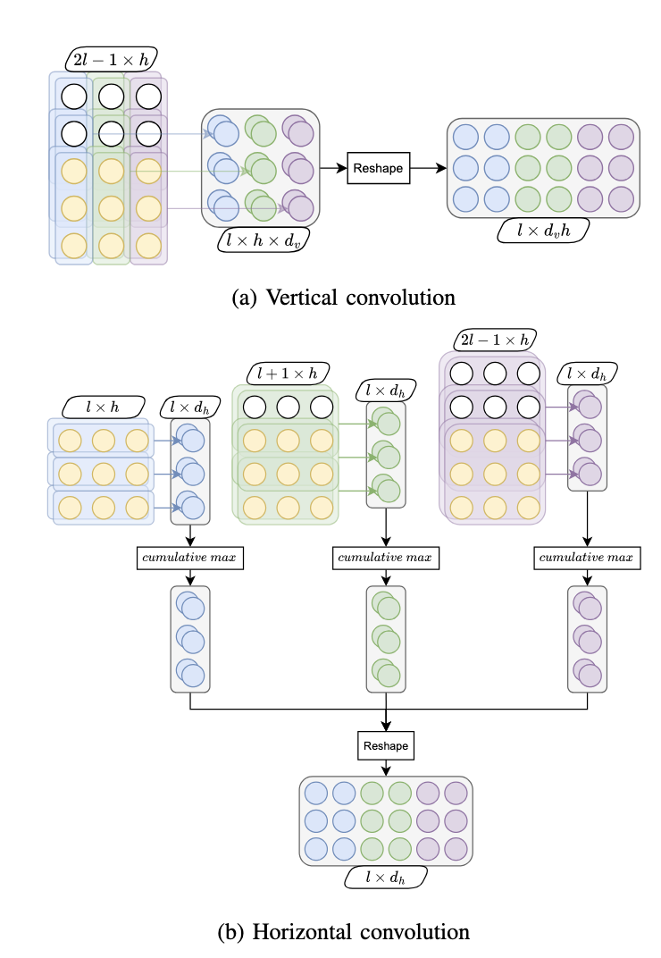
Caser+
For the vertical convolutional layer, we add left-padding equal to the length of the sequence minus one.
For the horizontal convolution, we left-pad the sequence and then apply a cumulative maximum operator along the first dimension.
Are Convolutional Sequential Recommender Systems Still Competitive? Introducing New Models and Insights

Slide 22
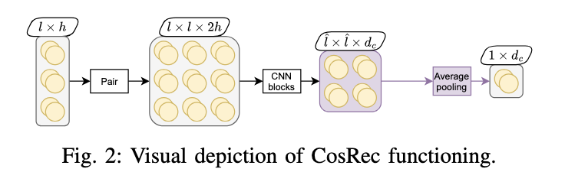
CosRec
CosRec pairs items together, generating a matrix of possible pairs of item embeddings in the input sequence.
This matrix is then passed through multiple convolutional layers.
Are Convolutional Sequential Recommender Systems Still Competitive? Introducing New Models and Insights

Slide 23
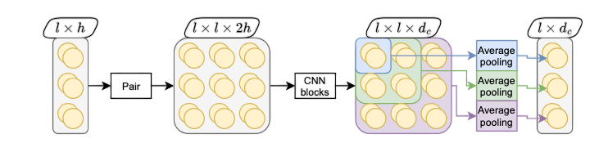
CosRec+
Are Convolutional Sequential Recommender Systems Still Competitive? Introducing New Models and Insights

Slide 24
CosRec+
We first apply left padding to each convolutional block.
For average pooling, starting with the value in the first row and column corresponding to the earliest time step, compute the average of each possible square matrix that can be generated.
Are Convolutional Sequential Recommender Systems Still Competitive? Introducing New Models and Insights

Slide 25




Experimental setup
Dataset: MovieLens 1M, Foursquare NYC and Foursquare TKY
Models: SASRec, Caser, CosRec, Caser+, CosRec+
Metrics: NDCG, Precision, Recall
Library: EasyRec
Are Convolutional Sequential Recommender Systems Still Competitive? Introducing New Models and Insights

Slide 26
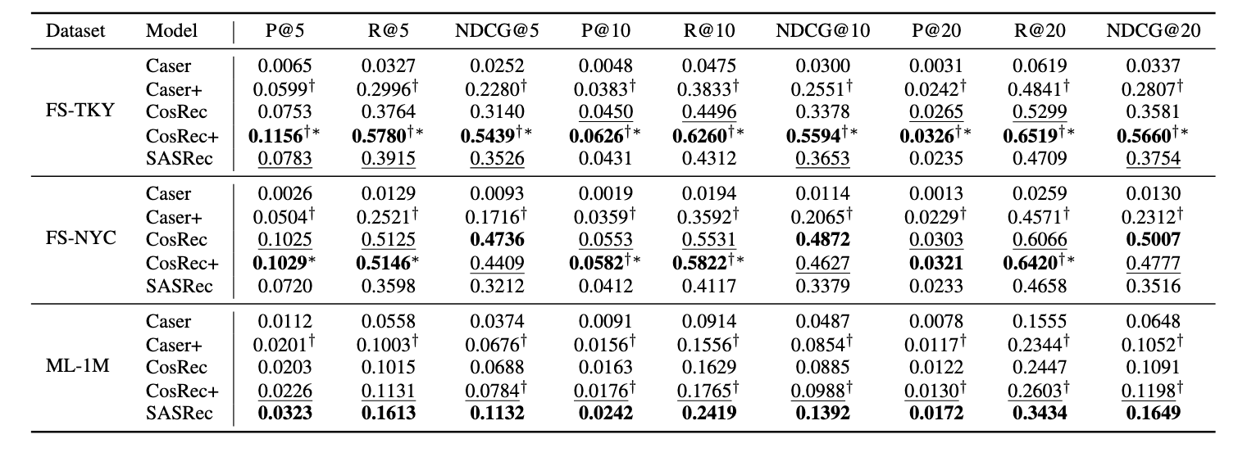
Results
Are Convolutional Sequential Recommender Systems Still Competitive? Introducing New Models and Insights

Slide 27
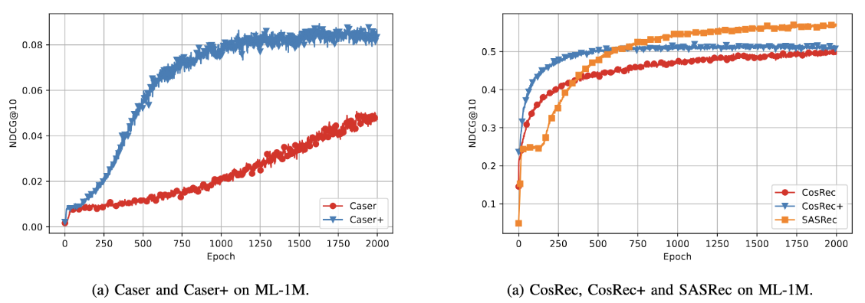
Results - MovieLens
Test performance between the original and improved Caser architectures on the left. During training, the improved architectures outperform their corresponding counterparts.
Are Convolutional Sequential Recommender Systems Still Competitive? Introducing New Models and Insights

Slide 28
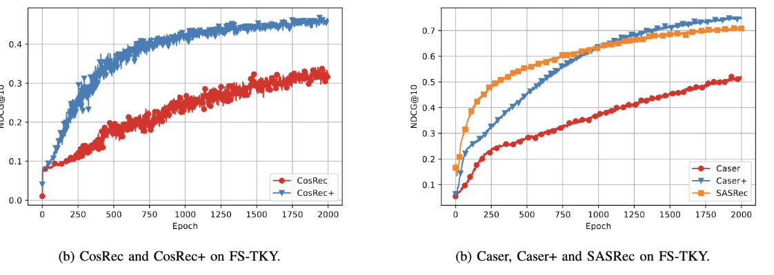
Results
On the right, same plot but with CosRec and the addition of SASRec. Our models remain competitive even in low-resource settings w.r.t. SASRec.
Are Convolutional Sequential Recommender Systems Still Competitive? Introducing New Models and Insights

Slide 29






Conclusions and future work
✉️ siciliano@diag.uniroma1.it
🌐 https://rstless.it/
@rstlessgroup
GitHub Code
Paper
This work showed that a modification
of convolutional-based models can greatly boosts their recommendation performance.
In future work we plan to perform a more in-depth analysis of convolutionals recommenders and how they can be improved.
EasyRec Library
Are Convolutional Sequential Recommender Systems Still Competitive? Introducing New Models and Insights

Slide 30
Sheaf4Rec: Sheaf Neural Networks for Graph-based Recommender Systems
ACM Transactions on Recommender Systems (TORS), 2025
Antonio Purificato, Giulia Cassarà, Federico Siciliano, Pietro Liò, Fabrizio Silvestri

Slide 31

Introduction
In many information services nowadays, relational data is naturally represented in the form of graphs.
Collaborative filtering is a class of methods for predicting users’ ratings for items on the basis of previous decisions made by similar users on that item.
The majority of the approaches is based on learned maps, incapable of representing the intrinsic characteristics of the connections.
Sheaf4Rec: Sheaf Neural Networks for Graph-based Recommender Systems

Slide 32
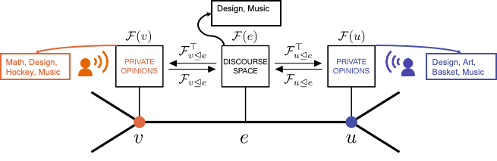
Background
In Sheaf Theory to each node 𝑣 is associated a vector space ℱ(𝑣) and to each edge 𝑒 a vector space ℱ(𝑒).
A restriction map, denoted as ℱ(𝑣⊴𝑒): ℱ(𝑣)→ℱ(𝑒) represents the relationship between local data on nodes and edges for each incident node-edge pair 𝑣⊴𝑒.
Sheaf4Rec: Sheaf Neural Networks for Graph-based Recommender Systems

Slide 33
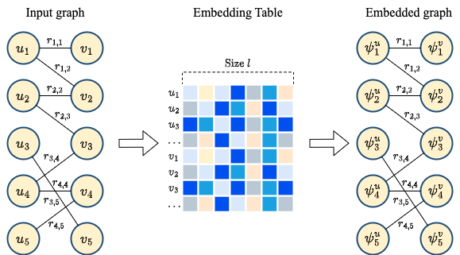
Method - Graph Creation
The input graph comprises users and items, forming a bipartite structure, with review values on edges. Using two embedding tables, one for the users and one for the items, the graph is transformed to its embedded version.
Sheaf4Rec: Sheaf Neural Networks for Graph-based Recommender Systems

Slide 34
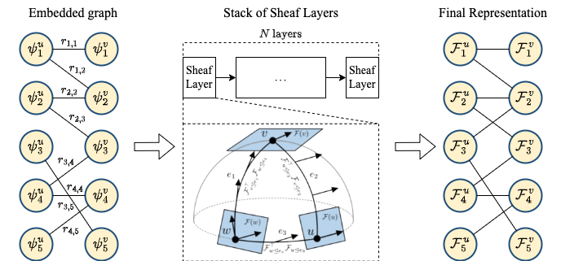
Method - Embedding
The input to the sheaf layers is the embedded graph obtained from the two embedding tables. In the sheaf layers, 0-cochains are mapped to user embeddings and 1-cochains to item embeddings. These embeddings are continuously updated.
Sheaf4Rec: Sheaf Neural Networks for Graph-based Recommender Systems

Slide 35
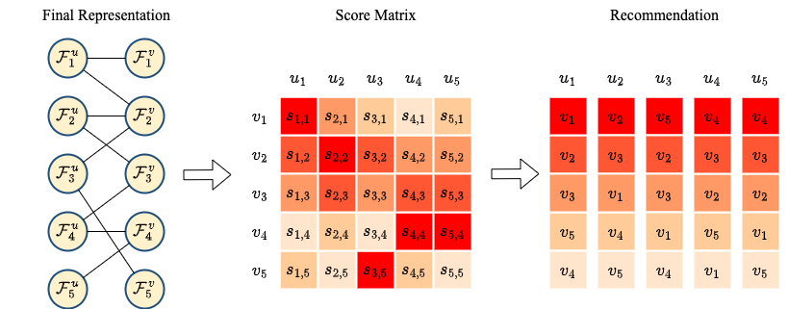
Method - Recommendation
The final step of the proposed pipelines consists in providing personalized recommendations to users. This involves computing a score for each user and item by performing matrix multiplication between the user embedding and the item embedding. Finally, scores are ranked to present each user with the most relevant items.
Sheaf4Rec: Sheaf Neural Networks for Graph-based Recommender Systems

Slide 36
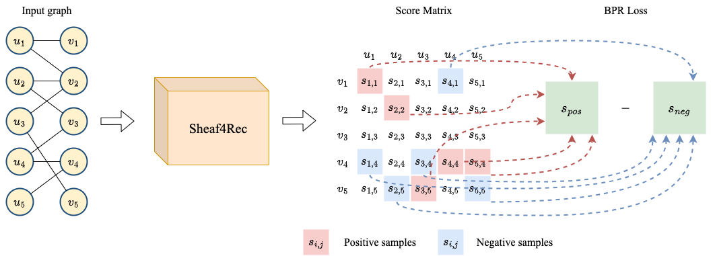
Method - Full Pipeline
During training, Sheaf4Rec takes as input the user-item graph, and generates a score matrix S that encapsulates the computed relevance of each item j for each user i. To compute the loss function, we extract the scores corresponding to both positive items and negative items.
Sheaf4Rec: Sheaf Neural Networks for Graph-based Recommender Systems

Slide 37

Experimental Setup
Dataset: MovieLens 1M, Facebook Books, Yahoo! Movies, Amazon Beauty
Performance metric: F1@K, MRR@K, NDCG@K
Loss function: Bayesian Personalised Ranking loss
Pytorch + NVIDIA RTX A6000
Sheaf4Rec: Sheaf Neural Networks for Graph-based Recommender Systems

Slide 38
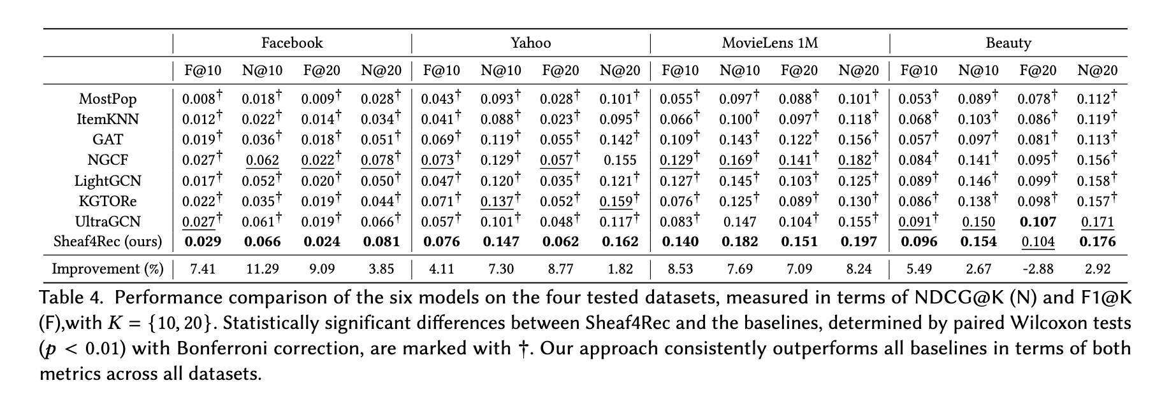
Results
Sheaf4Rec: Sheaf Neural Networks for Graph-based Recommender Systems

Slide 39
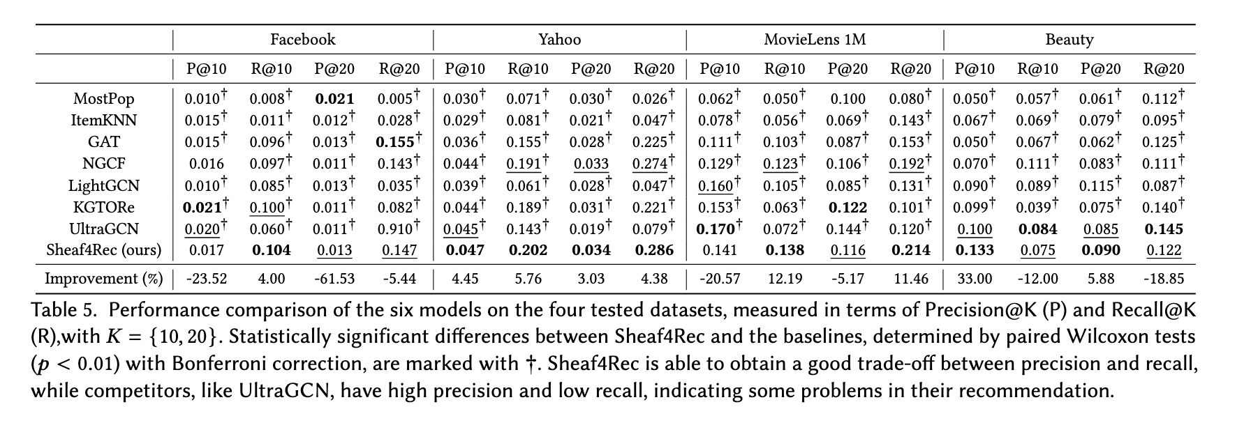
Precision & Recall
Sheaf4Rec: Sheaf Neural Networks for Graph-based Recommender Systems

Slide 40
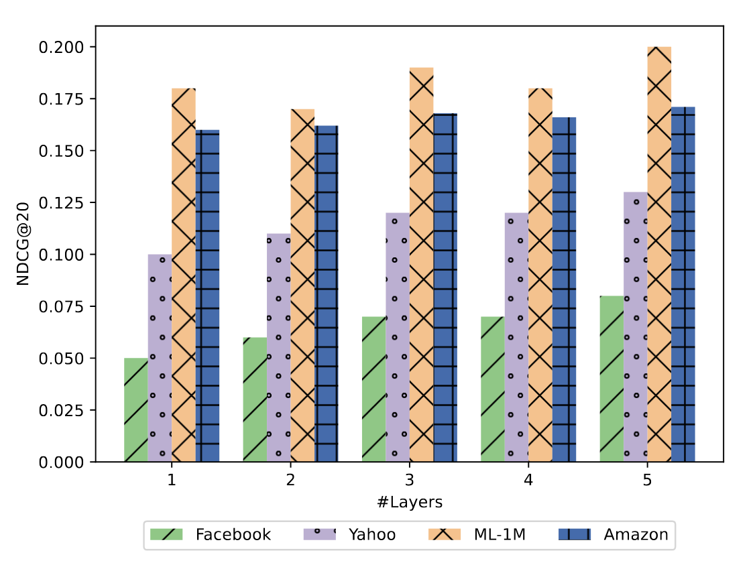
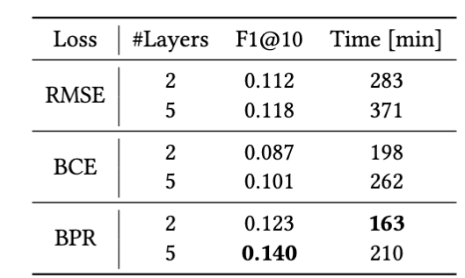
Loss Functions & Oversmoothing
Oversmoothing improvements
Impact of the BPR loss
Sheaf4Rec: Sheaf Neural Networks for Graph-based Recommender Systems

Slide 41
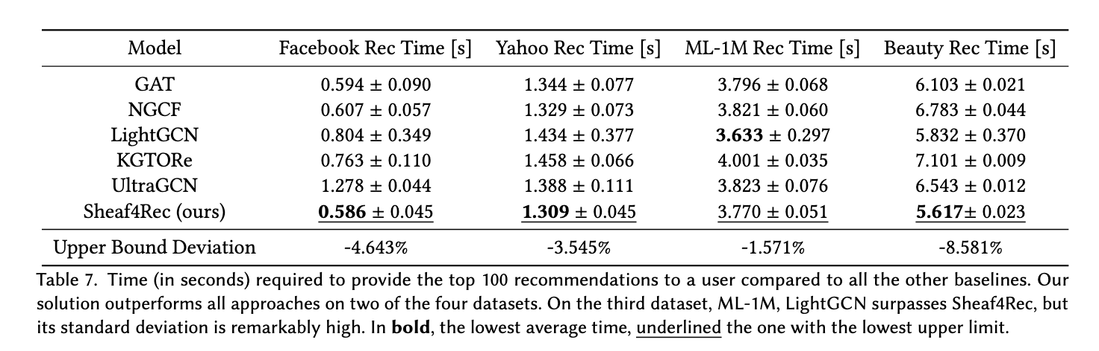
Recommendation Time
Sheaf4Rec: Sheaf Neural Networks for Graph-based Recommender Systems

Slide 42
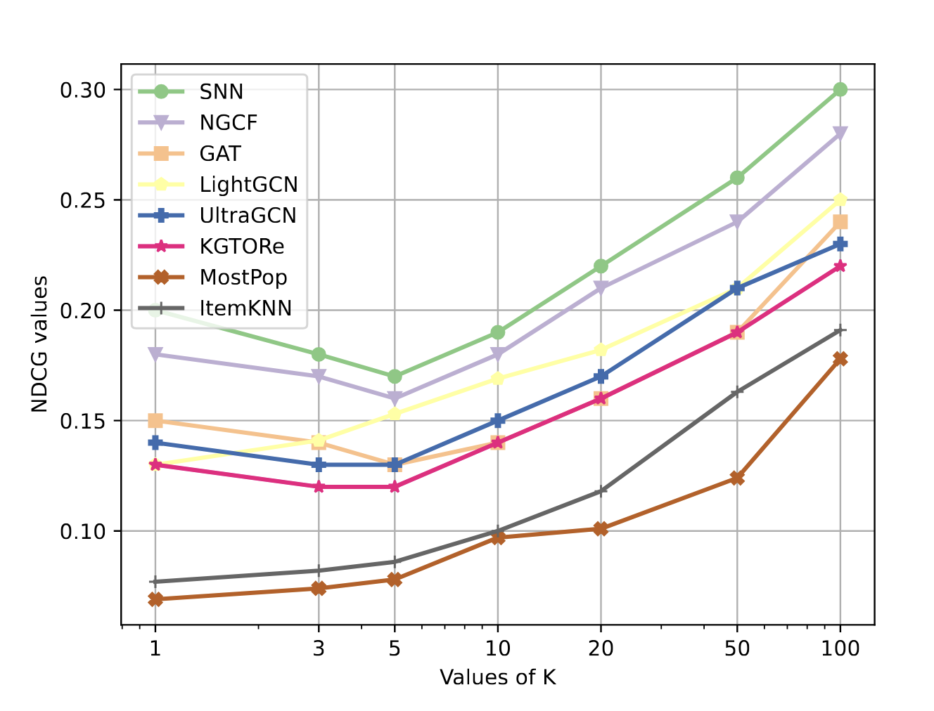
Stability of Metrics
Sheaf4Rec: Sheaf Neural Networks for Graph-based Recommender Systems

Slide 43


Future Work
This work showed how to integrate Sheaf theory in the context of recommender systems.
The results show that our method is able to recommend items in a small amount of time, showing its potential applicability into a real-world scenario.
Two possible research directions could be Next Point-Of-Interest recommendation and Deep Semantic Similarity Models.
Paper
Sheaf4Rec: Sheaf Neural Networks for Graph-based Recommender Systems

Slide 44



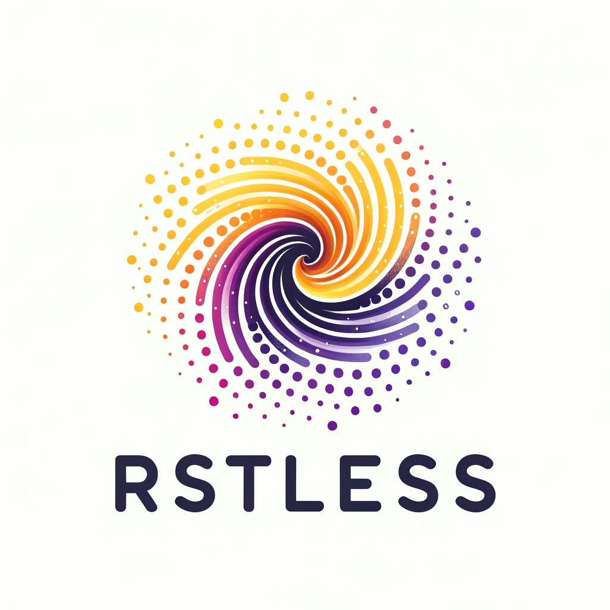
Eco-Aware Graph Neural Networks for
Sustainable Recommendations
International Workshop on Recommender Systems for Sustainability and Social Good (RecSoGood 2024)
Antonio Purificato, Fabrizio Silvestri

Slide 45



Introduction
Recommender systems (RSs) are able to provide personalized recommendations across various platforms, including e-commerce, streaming platforms and social networks.
Eco-Aware Graph Neural Networks for Sustainable Recommendations - 18/10/2024

Slide 46
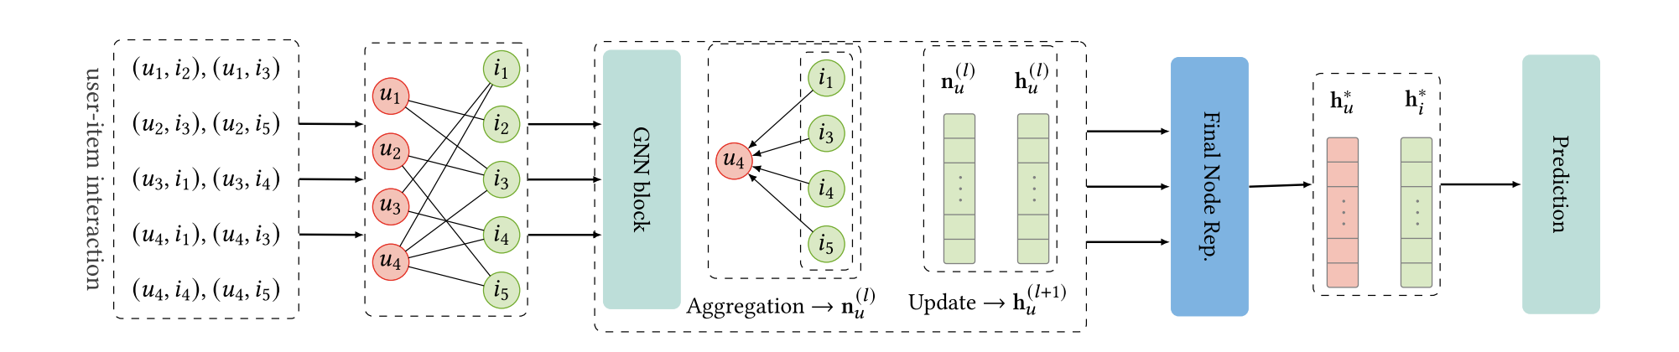
Task
Eco-Aware Graph Neural Networks for Sustainable Recommendations

Slide 47

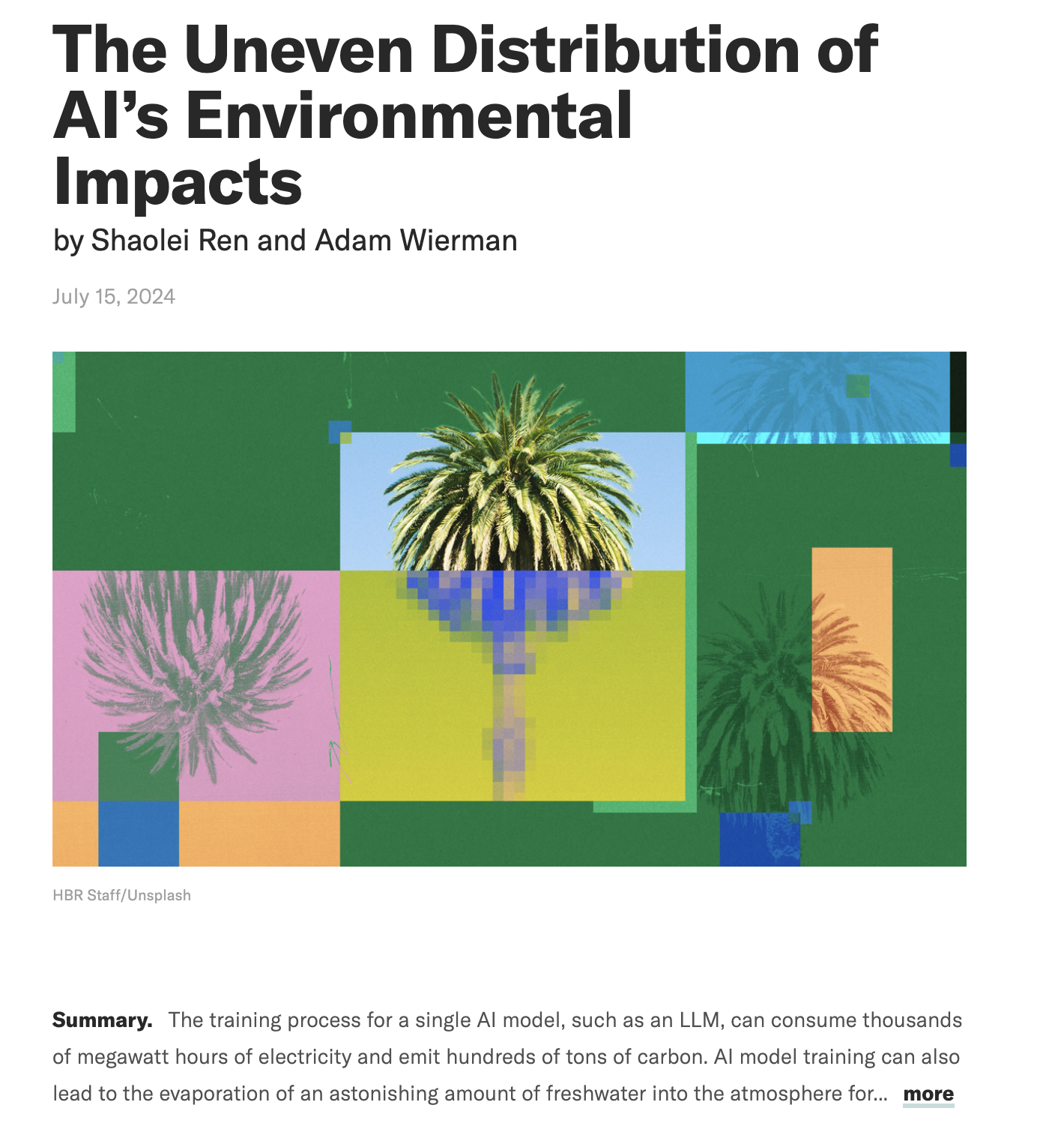
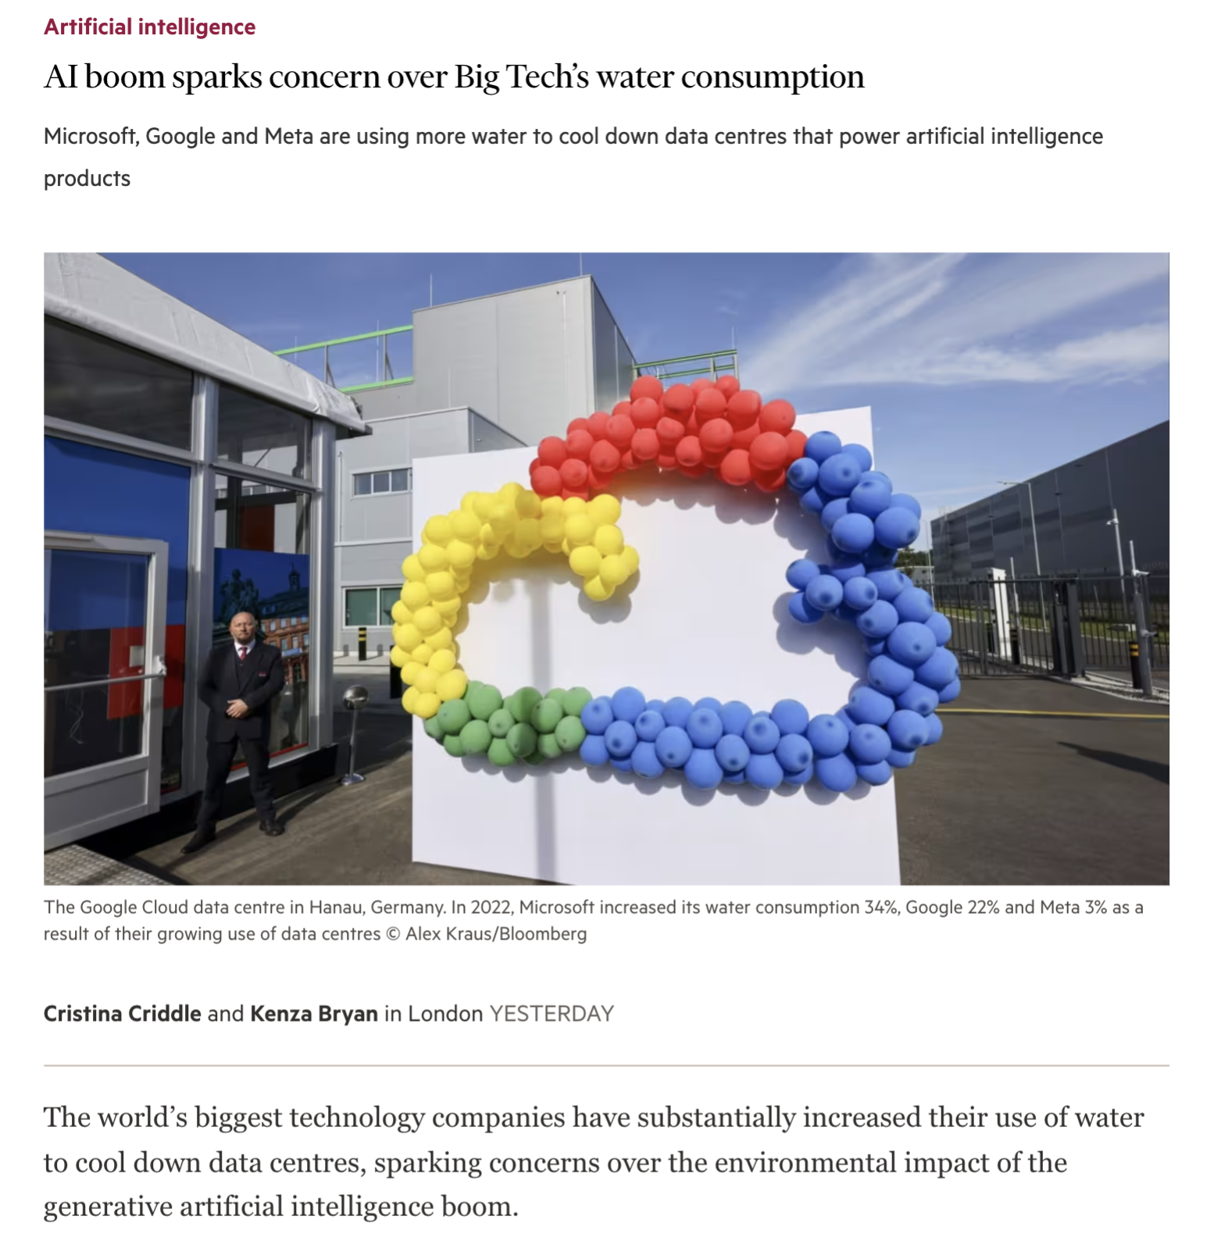
Motivation
The Financial Times (02/02/24)
US Congress (02/02/24)
Harvard Business Review (15/07/24)
Eco-Aware Graph Neural Networks for Sustainable Recommendations

Slide 48

Computing CO₂ Emissions
CO₂-eq [kg] = C 𑁦 E
C = Carbon Intensity of the electricity consumed for computation (quantified as g of CO₂ emitted per kilowatt-hour of electricity).
E = Energy Consumed by the computational infrastructure (quantified as kilowatt-hours).
Eco-Aware Graph Neural Networks for Sustainable Recommendations

Slide 49
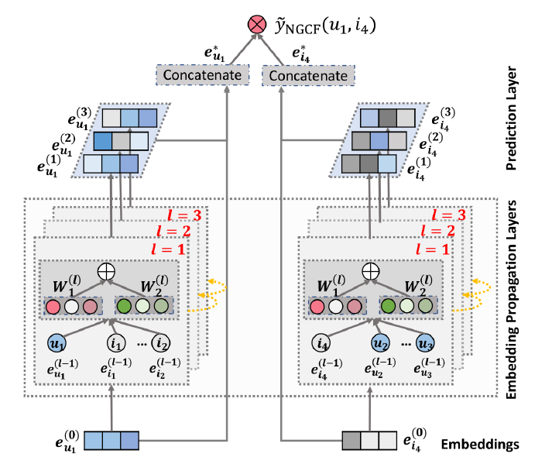
Models - NGCF
Eco-Aware Graph Neural Networks for Sustainable Recommendations

Slide 50
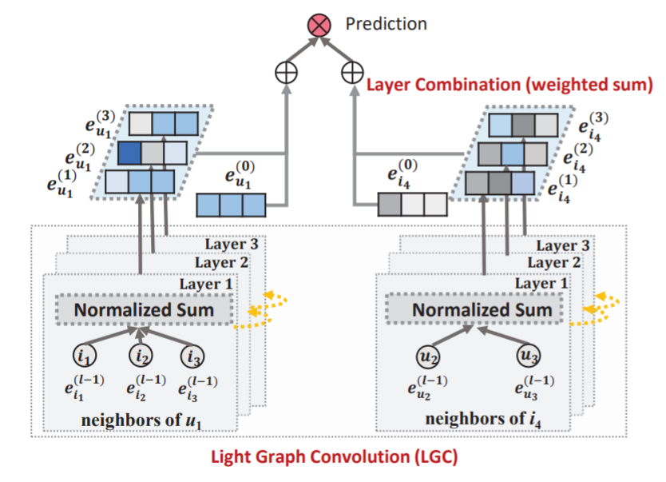
Models - LightGCN
Eco-Aware Graph Neural Networks for Sustainable Recommendations

Slide 51
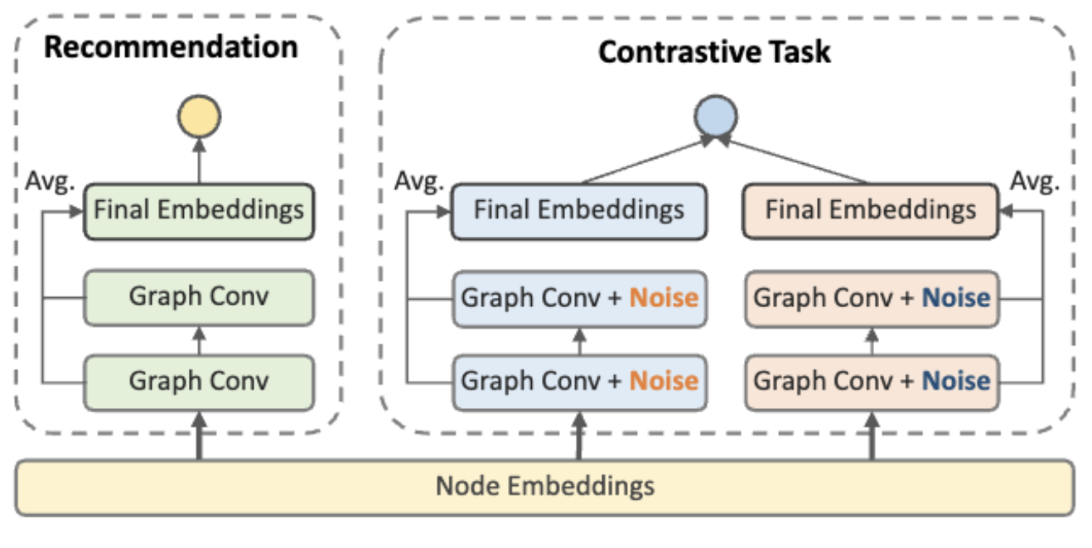
Models - SimGCL
Eco-Aware Graph Neural Networks for Sustainable Recommendations

Slide 52
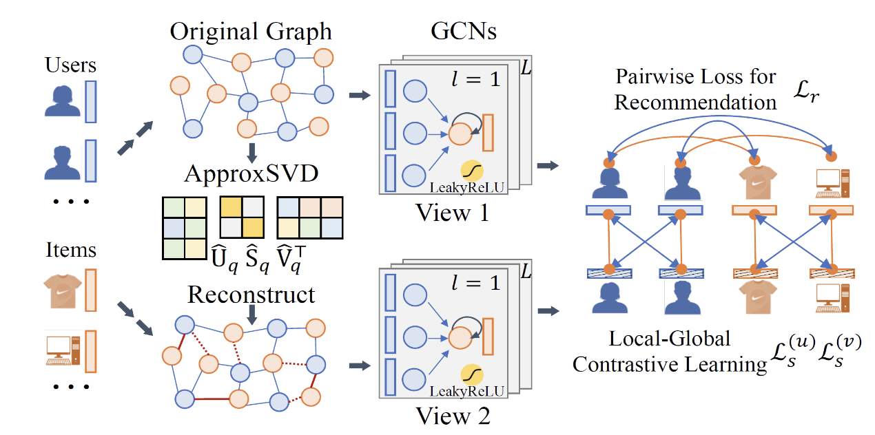
Models- LightGCL
Eco-Aware Graph Neural Networks for Sustainable Recommendations

Slide 53



Experimental setup
Datasets: Amazon Beauty, MovieLens 1M, DianPing;
Models: LightGCN, NGCF, LightGCL, SimGCL;
Metrics: NDCG, Precision, Recall, Hit, CO2-Eq;
Eco-Aware Graph Neural Networks for Sustainable Recommendations

Slide 54
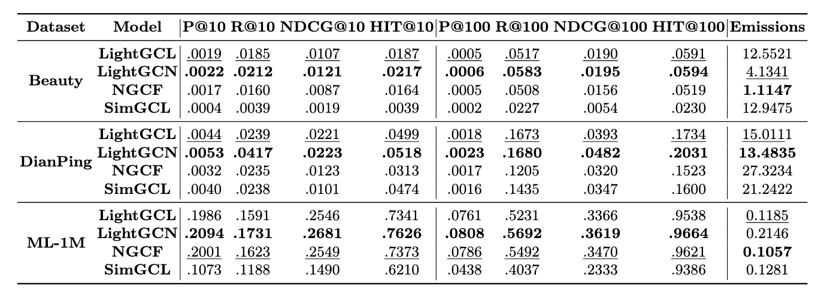
Results: Emissions vs Rec. Quality
Eco-Aware Graph Neural Networks for Sustainable Recommendations

Slide 55
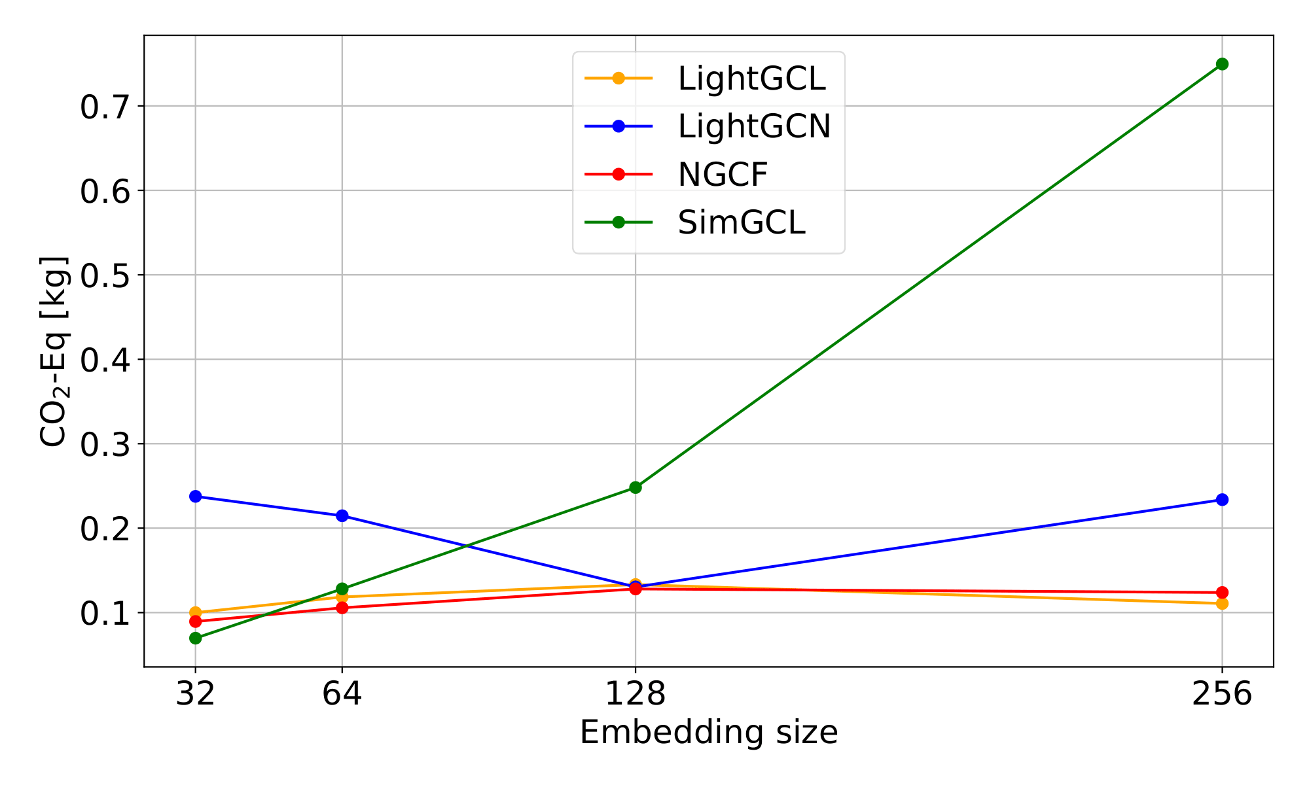
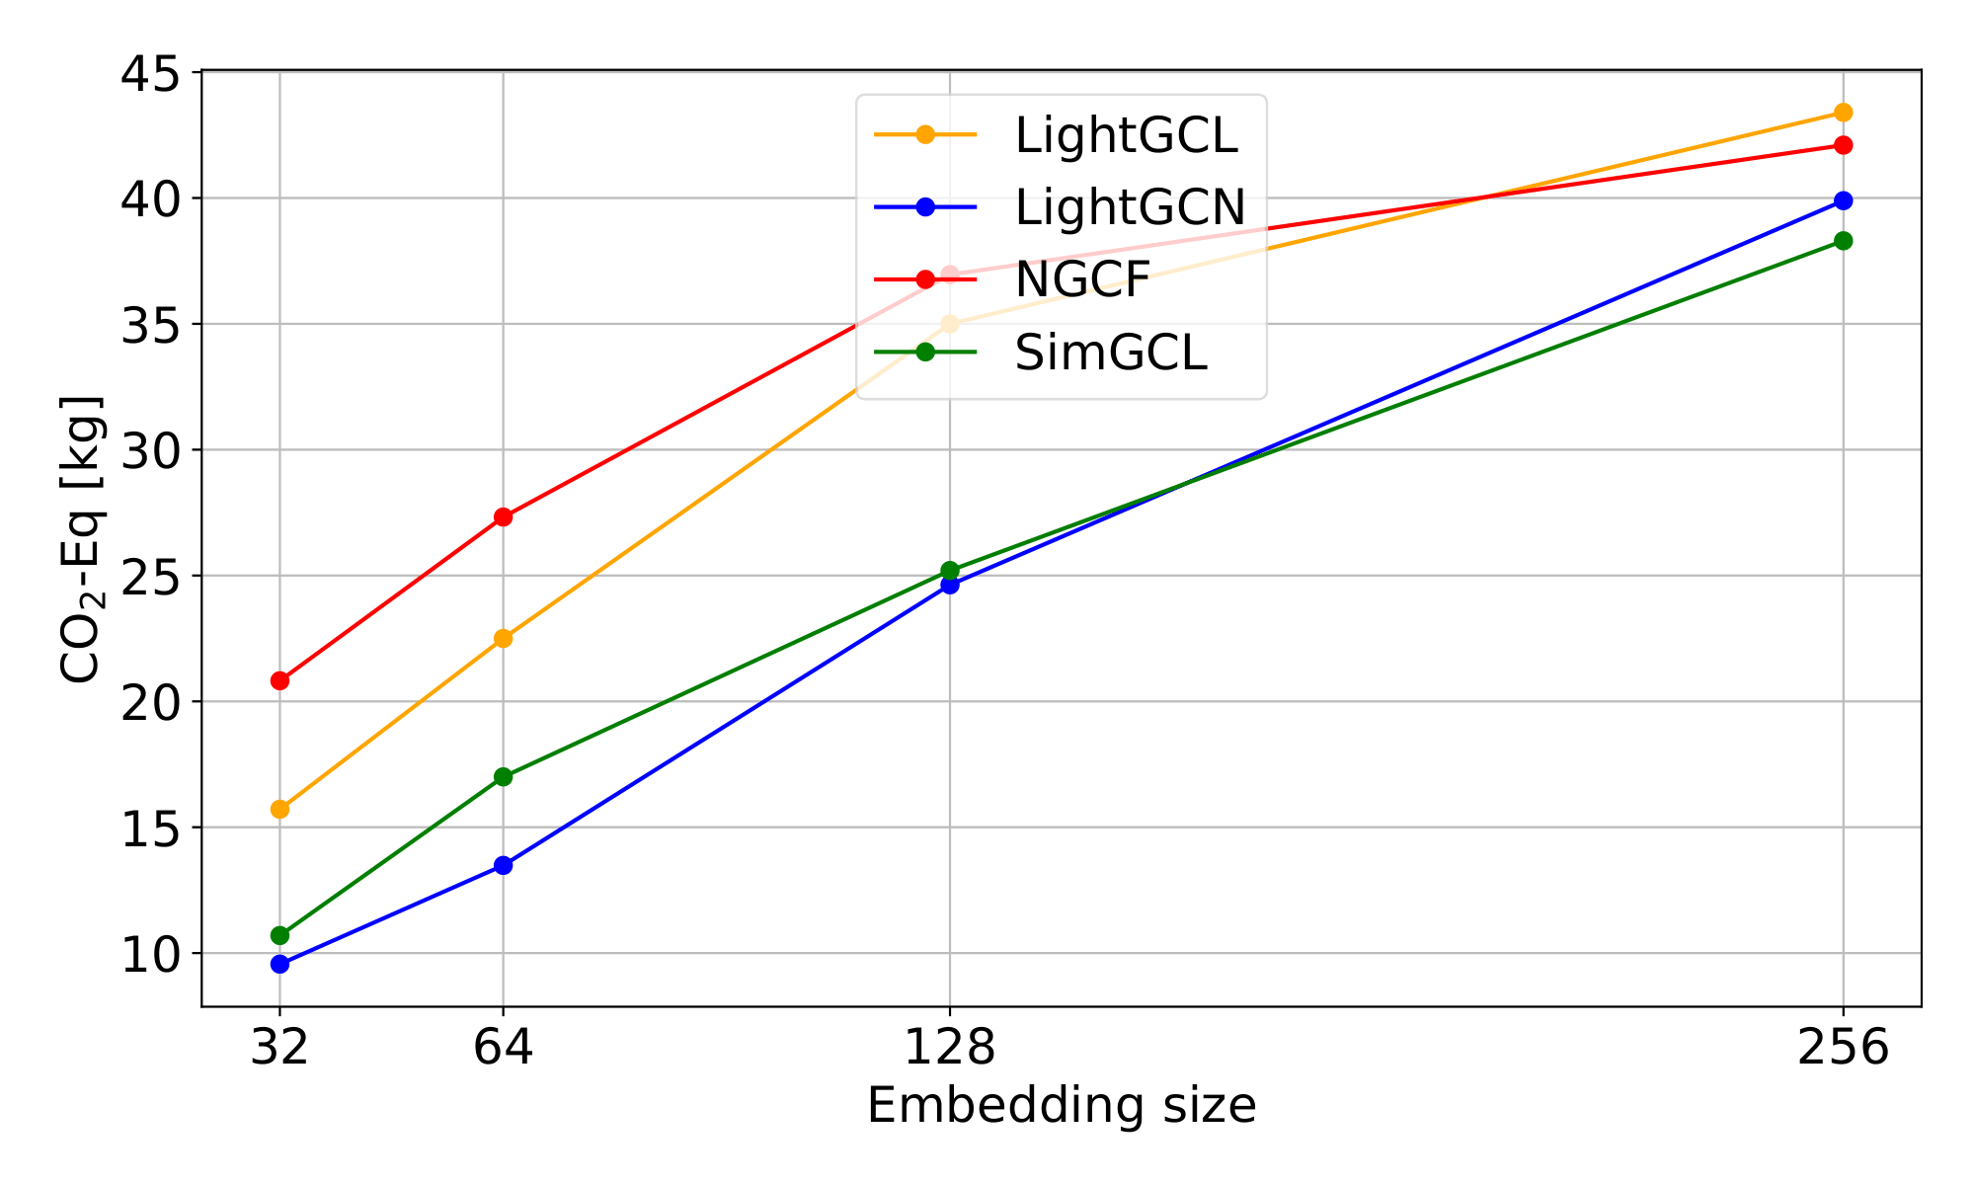
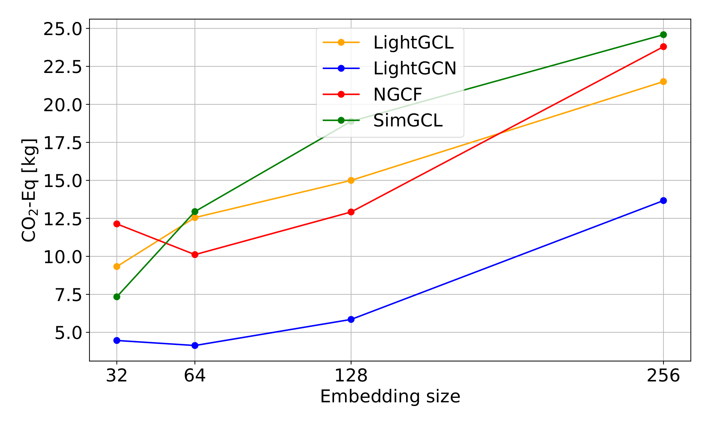
Results: Emissions vs Embedding Size
MovieLens 1M
DianPing
Amazon Beauty
Eco-Aware Graph Neural Networks for Sustainable Recommendations

Slide 56





Conclusions and future work
✉️ purificato@diag.uniroma1.it
🌐 https://rstless.it/
@AntonioPuri00
This work showed how the embedding size of GNN-based recommender systems influences their environmental impact.
Our findings show that gains in performance can come with considerable environmental costs, especially when using large datasets.
Future research should focus on optimizing GNN architectures to balance performance with sustainability.
Github Code
Paper
Eco-Aware Graph Neural Networks for Sustainable Recommendations
Notes:
metti mail e github link

Slide 57
Bibliography
[1] AI boom sparks concern over Big Tech’s water consumption, Financial Times.
[2] The Uneven Distribution of AI’s Environmental Impacts, Harvard Business Review.
[3] Graph Neural Networks in Recommender Systems: A Survey, Wu et al.
[4] Codecarbon, codecarbon.io.
[5] LightGCN: Simplifying and Powering Graph Convolution Network for Recommendation, He et al.
[6] Neural Graph Collaborative Filtering, Wang et al.
[7] Are Graph Augmentations Necessary?: Simple Graph Contrastive Learning for Recommendation, Yu et al.
[8] LightGCL: Simple Yet Effective Graph Contrastive Learning for Recommendation, Cai et al.
Eco-Aware Graph Neural Networks for Sustainable Recommendations

